Slide 1
Introduction
Probability

Slide 2
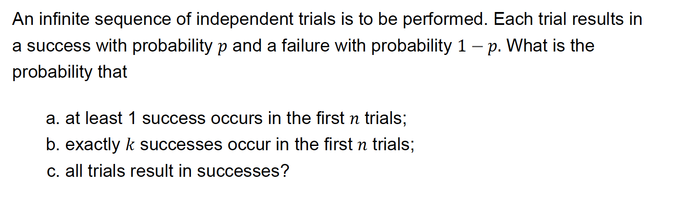
Example 1

Slide 3
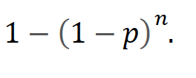
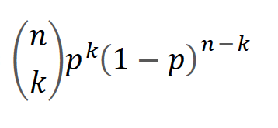

Example 1

Slide 4
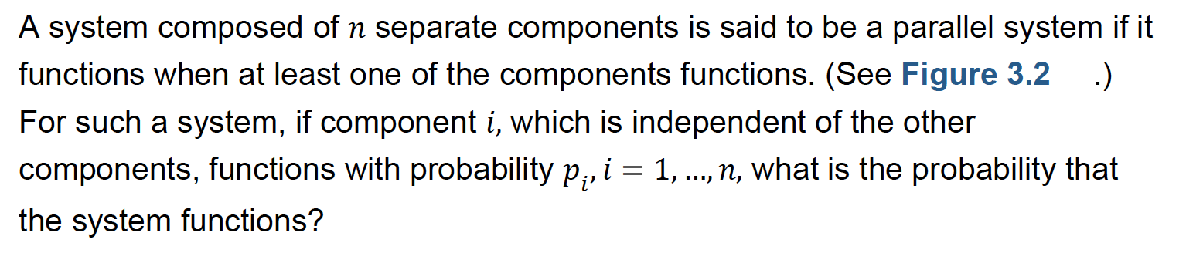
Example 2

Slide 5
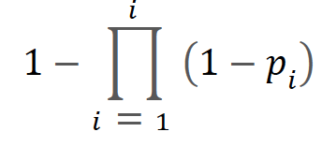
Example 2

Slide 6
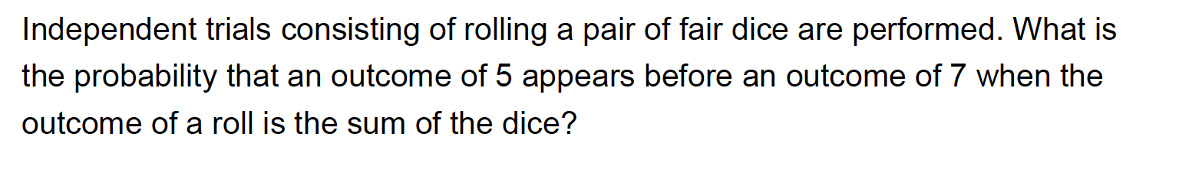
Example 3

Slide 7
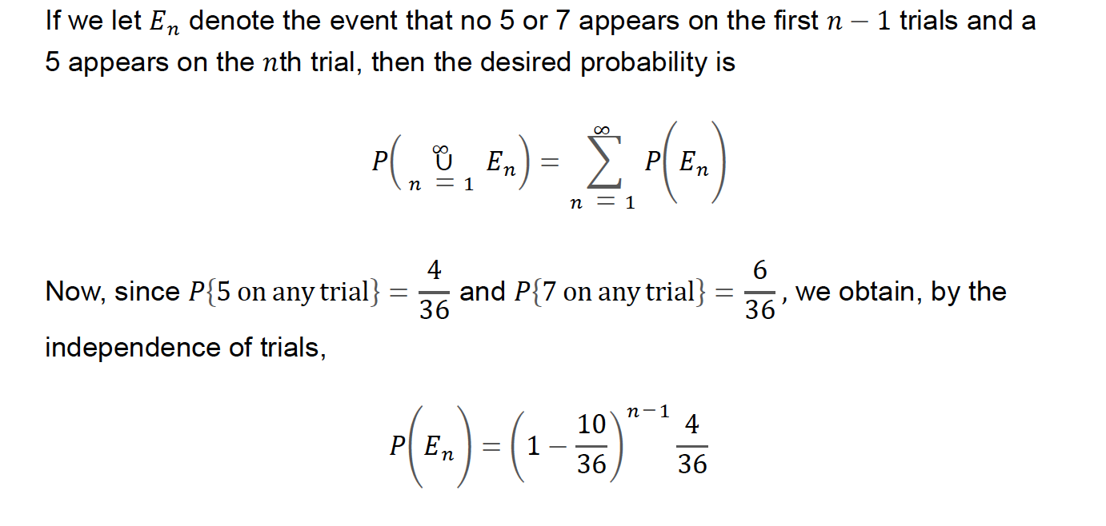
Example 3

Slide 8
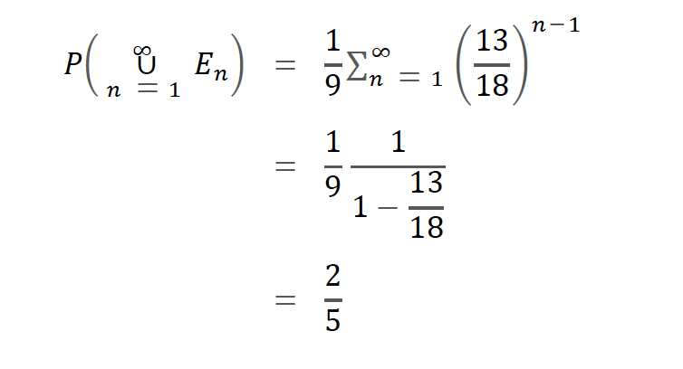
Example 3

Slide 9
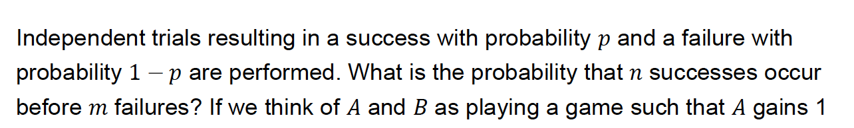
Example 4

Slide 10
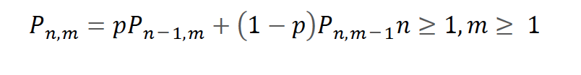


Example 4

Slide 11
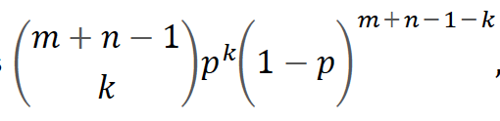
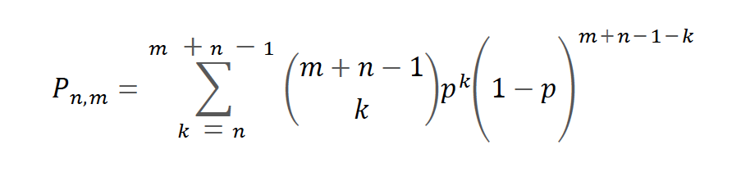

Example 4
There should be at least $n$ successes in first $(n+m−1)$ trials.
At least $n$ successes, atmost $m−1$ failures
In other words, $n$ successes before $m$failures.
Exactly $k$ successes in first $(n+m−1)$ trials

Slide 12
Random Variables
Discrete: Set of outcomes is a sequence.
Event : Flipping two heads
Outcome : { HH, HT, TH, TT }
Probability mass function: p(a) = P(X = a)
Cumulative distribution function: F(a) = P(X <= a)
P(1) = ½, P(2) = 1/3, P(3) = 1/6
F(<1) = 0
F( 1 ≤ x < 2) = 1/2
F( 2 ≤ x < 3) = 5/6
F( 3 ≤ x ) = 1
1 2 3
1 2 3

Slide 13
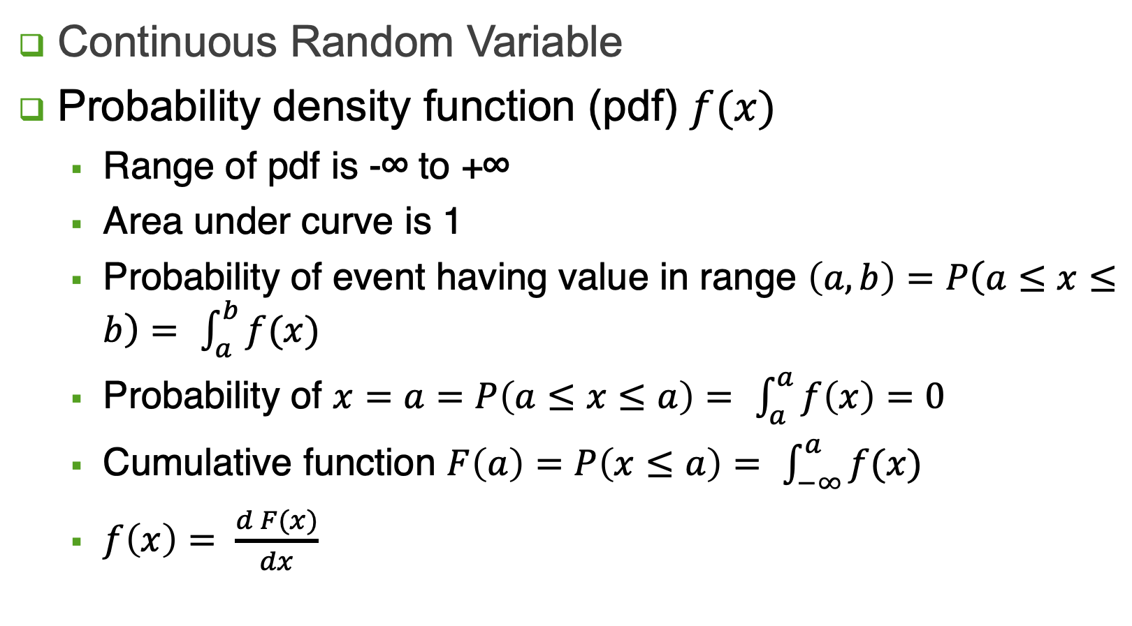
Continuous Random Variable
Continuous Random Variable
Probability density function (pdf) $f(x)$
Range of pdf is -∞ to +∞
Area under curve is 1
Probability of event having value in range $\left(a, b\right)=P\left(a≤x≤b\right)=$ $\int_{a}^{b}{f(x)}$
Probability of $x=a=P\left(a≤x≤a\right)=$ $\int_{a}^{a}{f\left(x\right)=0}$
Cumulative function $F\left(a\right)=P\left(x≤a\right)=$ $\int_{−∞}^{a}{f(x)}$
$f\left(x\right)= \frac{d F(x)}{dx}$

Slide 14
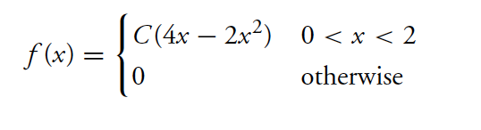
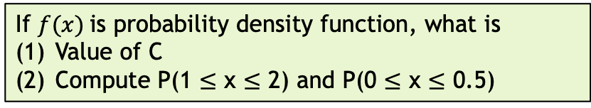
Example 1
If $f(x)$is probability density function, what is
Value of C
Compute P(1 $≤$ x $≤$ 2) and P(0 $≤$ x $≤$ 0.5)

Slide 15
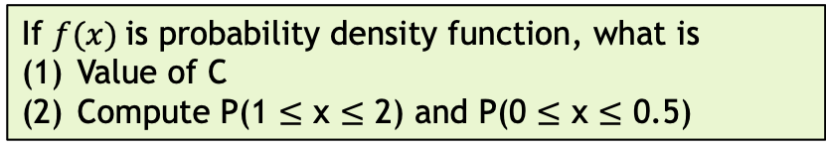
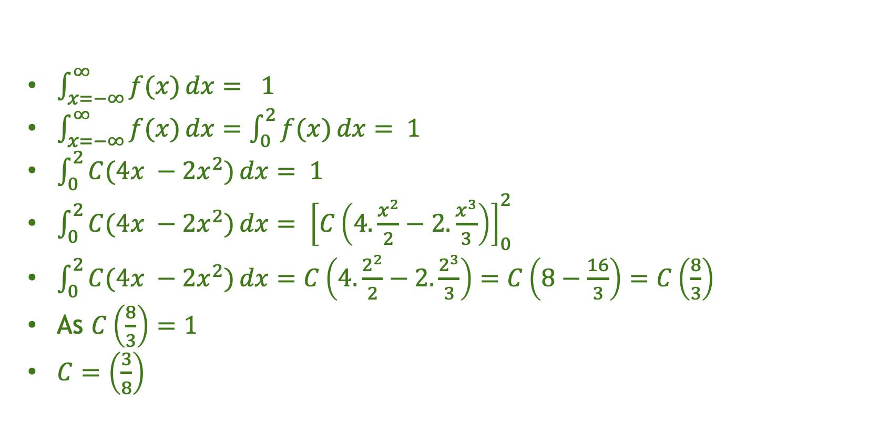
Example 1
If $f(x)$is probability density function, what is
Value of C
Compute P(1 $≤$ x $≤$ 2) and P(0 $≤$ x $≤$ 0.5)
$\int_{x=−∞}^{∞}{f(x)}dx= 1$
$\int_{x=−∞}^{∞}{f(x)}dx=\int_{0}^{2}{f(x)}dx= 1$
$\int_{0}^{2}{C(4x −2x^{2})}dx= 1$
$\int_{0}^{2}{C(4x −2x^{2})}dx= {\left[C\left(4.\frac{x^{2}}{2}−2.\frac{x^{3}}{3}\right)\right]}_{0}^{2}$
$\int_{0}^{2}{C(4x −2x^{2})}dx=C\left(4.\frac{2^{2}}{2}−2.\frac{2^{3}}{3}\right)=C\left(8−\frac{16}{3}\right)=C\left(\frac{8}{3}\right)$
As $C\left(\frac{8}{3}\right)=1$
$C=\left(\frac{3}{8}\right)$

Slide 16
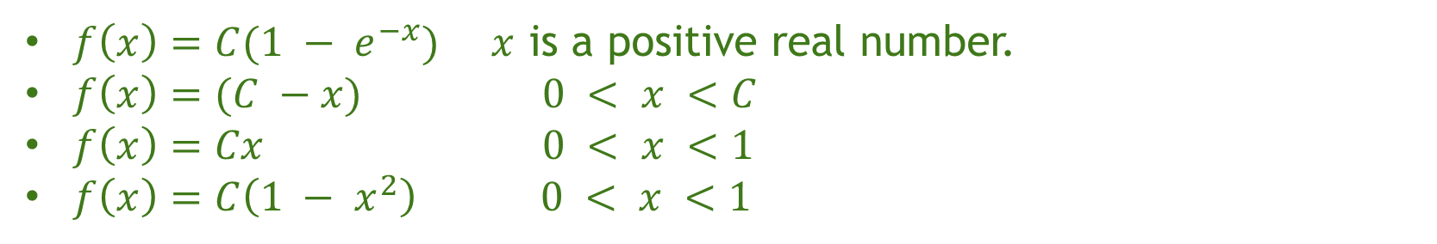
Exercises
Detemine unknown constants for the following density functions
$f\left(x\right)=C(1 − e^{−x})$ $x$ is a positive real number.
$f\left(x\right)=(C −x)$ $0 < x <C$
$f\left(x\right)=Cx$ $0 < x <1$
$f\left(x\right)=C\left(1 − x^{2}\right) 0 < x <1$

Slide 17
Reading Assignment
Reading Assignment: https://web.mit.edu/urban_or_book/www/book/chapter7/7.1.3.html

Slide 18
Joint Distributions

Slide 19
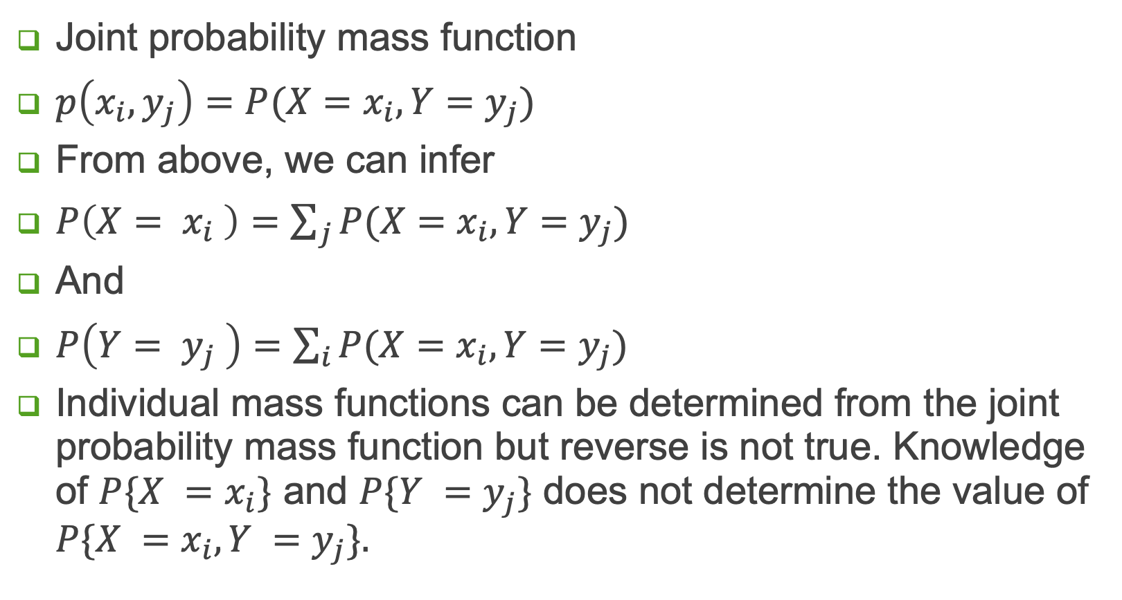
Discrete Variables
Joint probability mass function
$p\left(x_{i},y_{j}\right)=P(X=x_{i}, Y=y_{j})$
From above, we can infer
$P\left(X= x_{i} \right)=\sum_{j}{P(X=x_{i}, Y=y_{j})}$
And
$P\left(Y= y_{j} \right)=\sum_{i}{P(X=x_{i}, Y=y_{j})}$
Individual mass functions can be determined from the joint probability mass function but reverse is not true. Knowledge of $P\{X =x_{i}\}$ and $P\{Y =y_{j}\}$ does not determine the value of $P\{X =x_{i}, Y =y_{j}\}.$

Slide 20
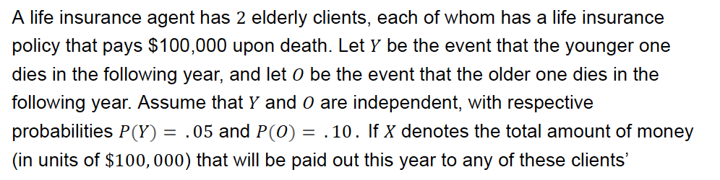
Example 5
determine probability P(X) for all possible values of X

Slide 21

Example 5
determine probability P(X) for all possible values of X
$$P(X = 0) = 0.855$$
$$P(X = 100,000) = 0.140$$
$$P(X = 200,000) = 0.005$$

Slide 22
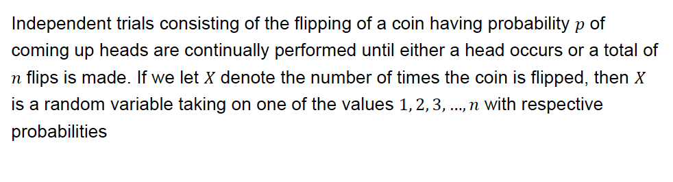
Example 6

Slide 23
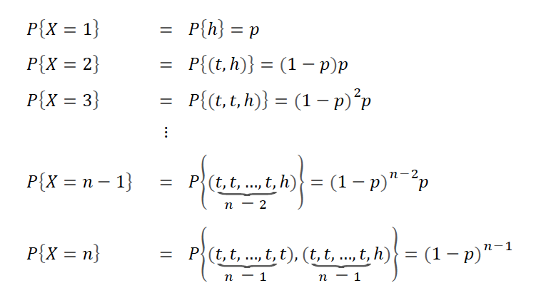
Example 6

Slide 24
Example 7
3 batteries are randomly chosen from a group of 3 new, 4 used but still working, and 5 defective batteries. If we let X denotes the number of new and Y denotes the number of used but still working batteries that are chosen, then what is the the joint probability mass function of X and Y?

Slide 25
Example 7
3 batteries are randomly chosen from a group of 3 new, 4 used but still working, and 5 defective batteries. If we let X denotes the number of new and Y denotes the number of used but still working batteries that are chosen, then what is the the joint probability mass function of X and Y?

Slide 26
Exercise
4 batteries are randomly chosen from a group of 3 new, 4 used but still working, and 5 defective batteries. If we let X denotes the number of new and Y denotes the number of defective batteries that are chosen, then what is the the joint probability mass function of X and Y?

Slide 27
Exercise
3 batteries are randomly chosen from a group of 4 new, 4 used but still working, and 2 defective batteries. If we let X denotes the number of new, Y denotes the number of used but still working and Z denotes the number of defective batteries that are chosen, then what is the joint probability mass function of X, Y and Z?

Slide 28
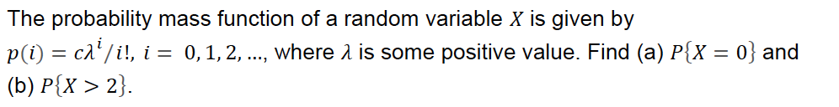
Example 7

Slide 29

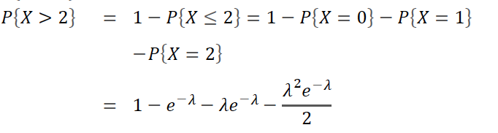
Example 7

Slide 30
Expected Value

Slide 31
Expectations
Random Variable: a variable whose values depend on outcomes of a random phenomenon
Example: Sum of two dices
P(1) = 0
P(2) = P(12) = 1/36
P(3) = P(11) = 2/36
P(4) = P(10) = 3/36
P(5) = P(9) = 4/36
P(6) = P(8) = 5/36
P(7) = 6/36
E(X) = ∑ XP(X)
= 2x1/36 + 3x2/36 + 4x3/36 + 5x4/36 + 6x5/36 + 7x6/36
+ 8x5/36 + 9x4/36 + 10x3/36 + 11x2/36 + 12x1/36
= 1/36 (2+6+12+20+30+42+40+36+30+22+12)
= 252/36 = 7
Encoding
Distribution of symbols is not uniforms
Number of bits allotted to more frequent symbols is less
Bits allotted x probability of symbol

Slide 32

Example 8

Slide 33
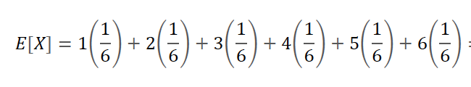
Example 8
Answer = 7/2

Slide 34
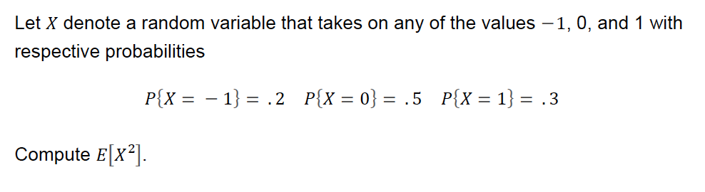
Example 9

Slide 35

Example 9
$$E\left(X2\right)= \left(−1\right)2 ∗ 0.2 + 02 ∗ 0.5 + 12 ∗ 0.3$$
$$= 1 ∗ 0.2 + 0 + 1 ∗ 0.3$$
$$= 0.5$$

Slide 36
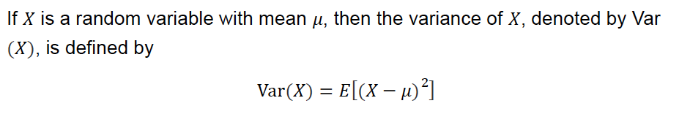
Variance of Random Variable

Slide 37
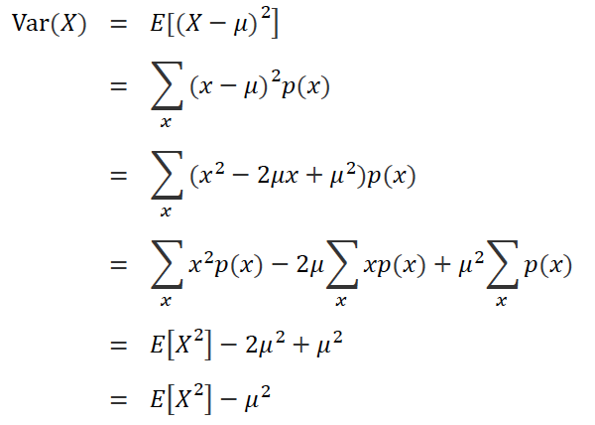

Variance of Random Variable

Slide 38
Example 10

Slide 39
Example 10
Answer : 35/12

Slide 40
Thank you.

